Slide 1

Project Proposal
Islamic Development Bank
Bangladesh Islamic Solidarity Educational Wakf
Hotel
Management System
Presented By ASSADUZZAMAN SHAON
Date: 09-Aug-2025

Slide 2
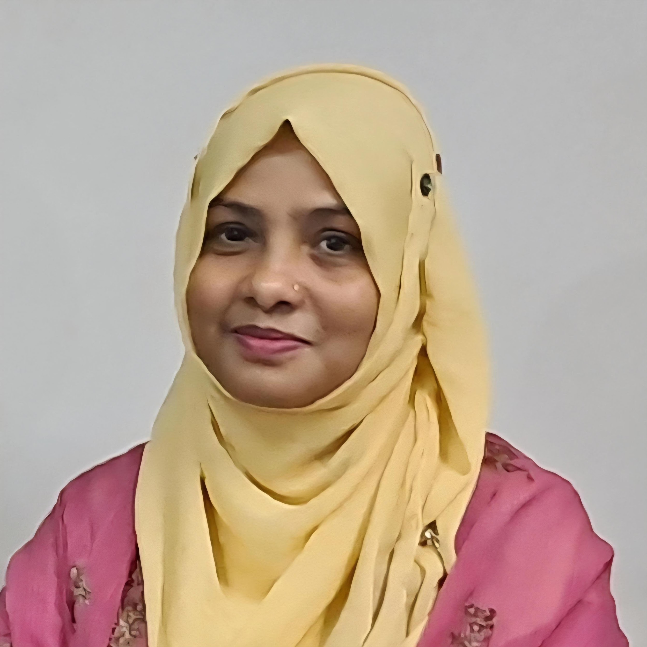
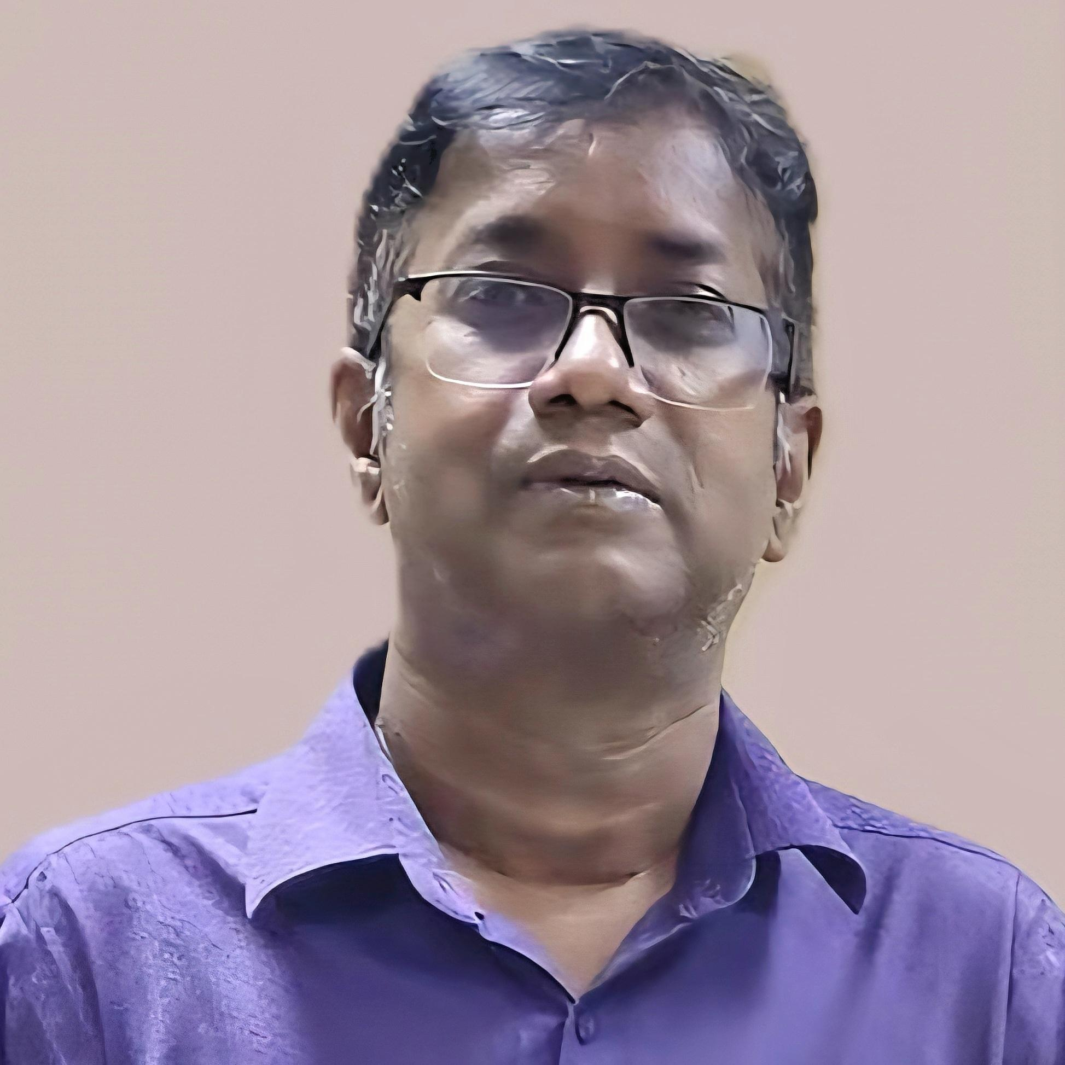
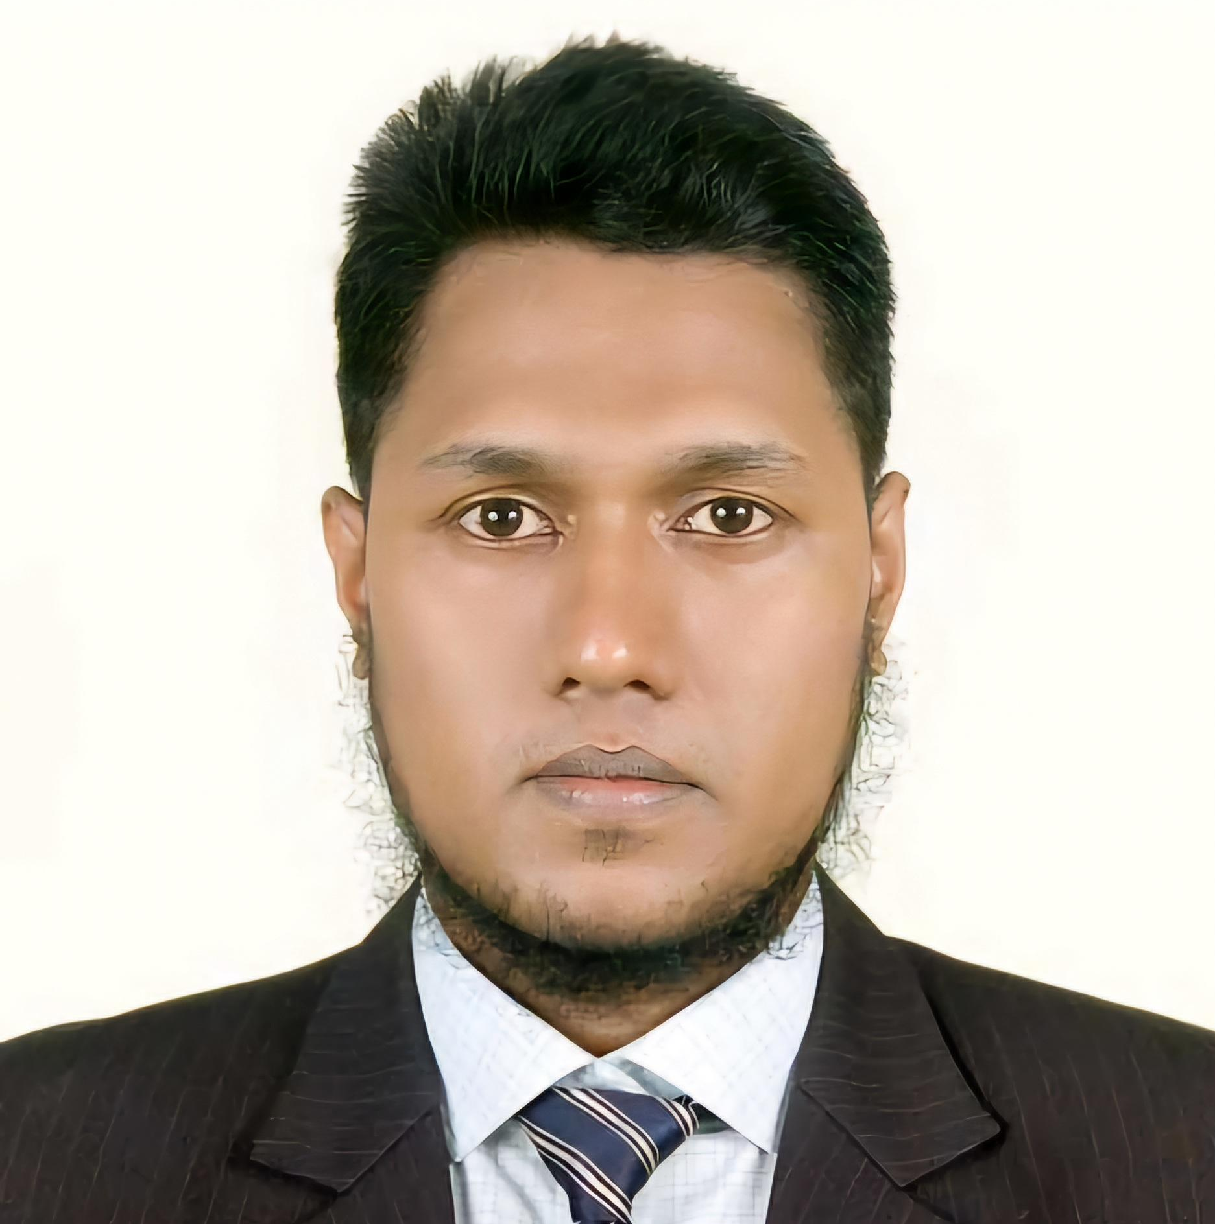
Acknowledgement I would like to express my sincere gratitude to Farhana akter Lucky, our course instructor, for guiding and supporting me throughout the development of this project titled “Hotel Management System.” I would also like to thank Md. Moshaidul Islam, Consultant Head, for giving me this opportunity. Finally, I’m thankful to my classmates, friends, and family for their constant encouragement and support. — Assaduzzaman Shaon
Farhana akter Lucky
Instructor
Email: farhana_lucky25@yahoo.com
IsDB-BISEW IT Scholarship Programme
Md. Moshaidul Islam
Consultant, WDPF
Email: moshaidul@gmail.com
IsDB-BISEW IT Scholarship Programme
Assaduzzaman Shaon
Trainee & Developer
Email: assad.uz255@gmail.com
IsDB-BISEW IT Scholarship Programme

Slide 3
To Date: 09-Aug-2025 Md. Moshaidul Islam Consultant Head, WDPF IsDB-BISEW IT Scholarship Programme IDB Bhaban, Sher-e-Bangla Nagar, Dhaka-1207, Bangladesh
Subject: Project Proposal Letter for the Hotel Management System
Respected Sir,
I am writing this letter to propose my project on “Hotel Management System” as a part of my academic requirements. This project will be developed using web technologies like PHP, MySQL, HTML, CSS, and Bootstrap.
The main objective of this system is to make the hotel booking and management process easier and more organized. The system will have two types of users: Admin and Customer.
Customers will be able to register, log in, view available rooms, make bookings, and complete payments.
Admins will be able to manage rooms, approve bookings, handle transactions, and view reports.
This project will help me learn about database design, user management, role-based access, and real-world problem-solving. I believe this system will be a good practical example of applying what I have learned in my coursework.
I kindly request you to accept my project proposal. I will try my best to complete it with sincerity and proper documentation.
Thank you for your time and support.
Sincerely, Assaduzzaman Shaon ID: 1288328
Round: 65 Course: WDPF Batch: WDPF/NCLC-M/65/01

Slide 4
Overview
Index
SL | Section Name | Page No
1. | Introduction | 5
2. | Target Audience | 6
3. | Project Scope | 7
4. | Software Features & Functionalities | 8
5. | Technological Overview | 9
6. | Software ER Diagram | 12
7. | Software Flowchart | 13
8. | User Roles and Access Control | 14
9. | User Interface Overview | 15
10. | Security Measures | 20
11. | Testing and Validation | 21
12. | Project Timeline Infographics | 22
13. | Budget | 23
14. | Conclusion | 24
15. | Q & A | 25
Give a brief overview of what you’ll cover in your presentation.

Slide 5
Introduction
Our Hotel Management System is designed to automate and simplify various daily hotel operations, including room booking, food and room services, check-in/check-out processes, and payment management. By digitizing these processes, the system aims to enhance efficiency, reduce manual errors, and improve customer satisfaction. This project facilitates both hotel administrators and customers, providing an easy-to-use platform to manage hotel services seamlessly.

Slide 6
Target Audience
Our Hotel Management System is designed to serve two main types of users:
◈ Admin (Hotel Staff):
Responsible for managing room bookings, check-ins, check-outs, food and room services, and overseeing payment transactions. The system provides them with easy-to-use tools to efficiently run daily hotel operations.
◈ Customer (Guests):
Able to browse available rooms, make bookings, request services, and manage payments conveniently through a user-friendly interface.
This system ensures both Admin and Customer have seamless access to the features they need, enhancing overall service quality and satisfaction.

Slide 7
Project Scope
The Hotel Management System aims to automate and streamline all core hotel operations to improve efficiency and service quality. The key areas covered by this system include:
◈ Room management including availability tracking and pricing
◈ Online booking and reservation handling
◈ Food and room service ordering and billing
◈ Guest check-in and check-out process management
◈ Payment processing and transaction tracking
◈ User roles management for both administrators and customers
◈ Generating reports for management to monitor hotel performance
This system is intended to reduce manual workload, minimize errors, and provide a seamless experience for both hotel staff and guests, ultimately enhancing overall operational effectiveness.

Slide 8
Software Features & Functionalities
Our Hotel Management System includes the following key features:
◈ User Registration and Authentication: Secure login for both admins and customers.
◈ Room Management: Add, update, and track room availability and pricing.
◈ Online Booking System: Customers can book rooms effortlessly through the platform.
◈ Food and Room Service Ordering: Manage and provide food and room services seamlessly.
◈ Check-in and Check-out Management: Streamlined processes for guest arrivals and departures.
◈ Payment Processing: Multiple payment methods with secure transaction handling.
◈ Invoice and Billing: Automated generation of invoices and billing statements.
◈ User Role Management: Different access levels and permissions for admins and customers.
◈ Reporting: Generate reports on bookings, payments, and occupancy for management insights.
◈ Cancellation and Refund Handling: Manage booking cancellations and refund processes effectively.

Slide 9








Technological Overviews
Our Hotel Management System is built using a modern and robust technology stack to ensure efficiency, scalability, and security. The key technologies involved include:
◈ Frontend ◈ Backend ◈ Database ◈ Web Server ◈ Tools & Frameworks

Slide 10
Technological Overviews
A brief overview of the key technologies and tools utilized in the development of the Hotel Management System, highlighting their role in ensuring efficiency, scalability, and security.
◈ Frontend: HTML5, CSS3, JavaScript — for building a responsive and user-friendly interface.
◈ Backend: PHP — to handle business logic and server-side operations.
◈ Database: MySQL — to store and manage all hotel data securely.
◈ Web Server: Apache (via XAMPP/WAMP) — to serve web pages and handle client requests.
◈ Tools & Frameworks: Bootstrap for styling and layout, and optionally jQuery for dynamic behavior.
◈ Security Measures: Password hashing, input validation, and secure session management to protect user data.
This technology combination provides a reliable platform for seamless hotel management operations.

Slide 11
Visual Representation of the System
This section illustrates the Entity–Relationship Diagram (ERD) and the Booking Process Flowchart for the Hotel Management System.

Slide 12
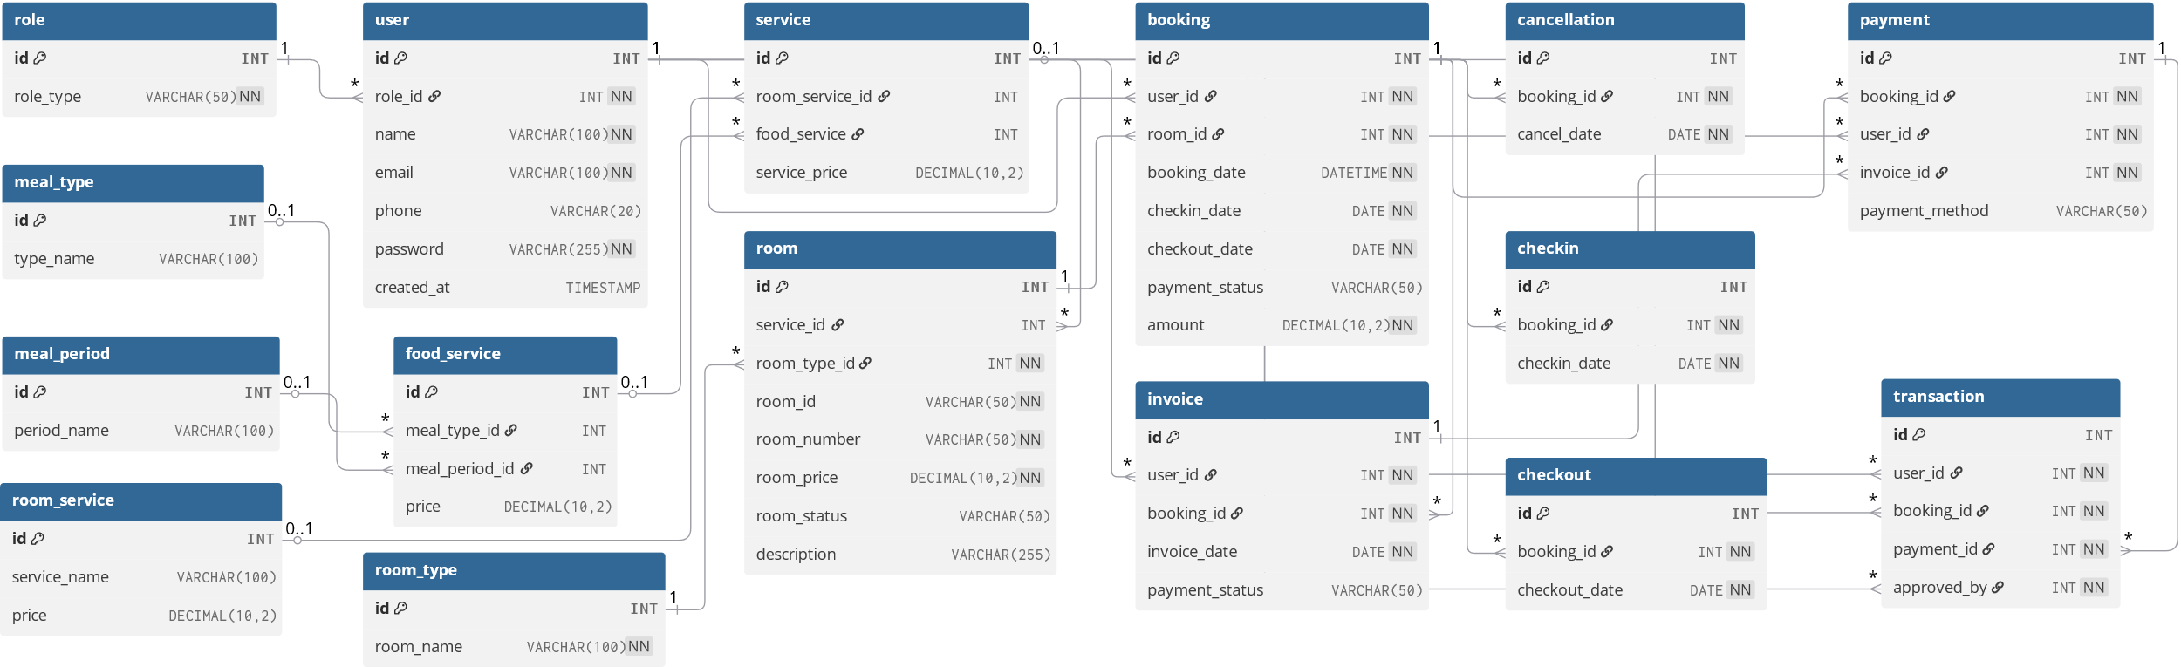
System ER Diagram

Slide 13
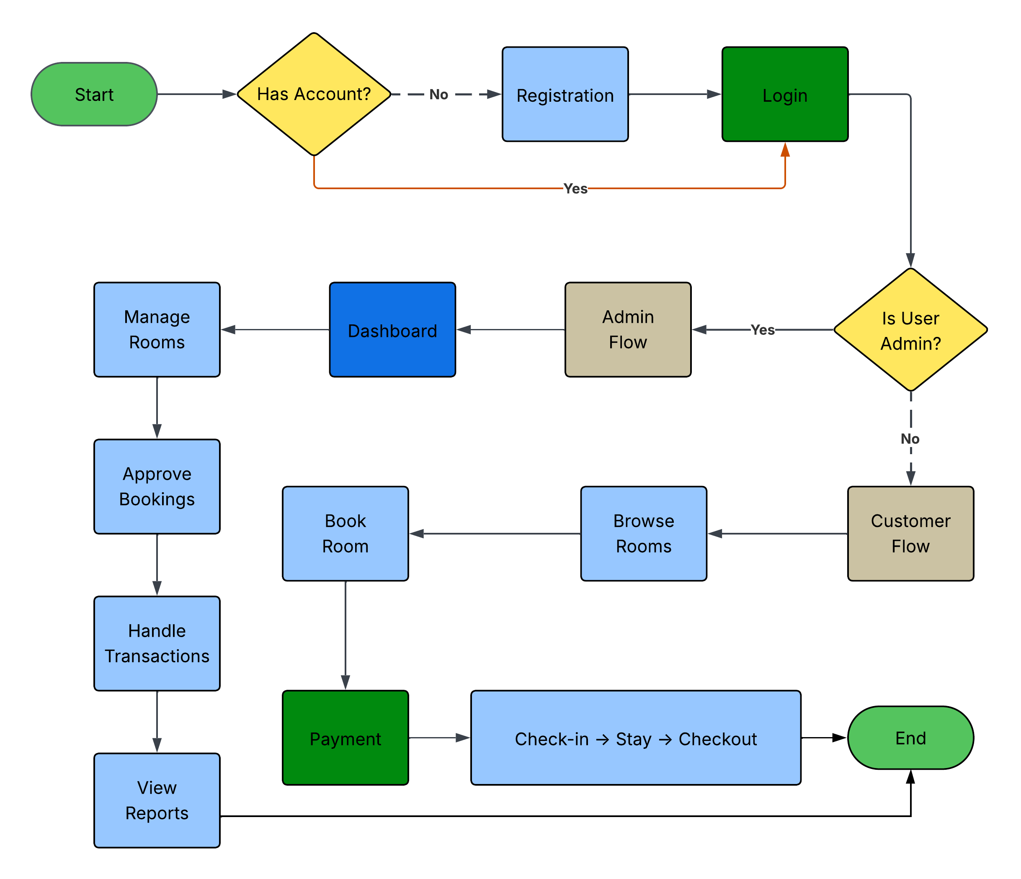
System Flowchart

Slide 14
User Roles and Access Control
◈ User Roles: This system includes two types of users.
● Admin: Has full access to manage the system, including room
management, bookings, and user control.
● Customer: Can view their profile and booking details, as well as
make new bookings.
◈ Access Control: Restricts users so that each role can only access authorized features and data. This ensures system security and protects sensitive information. For example, only Admin can modify room details, while Customers can only manage their own bookings.

Slide 15
User interface Overview
We aimed to create a clean, intuitive, and responsive design that ensures seamless interaction for all users.

Slide 16
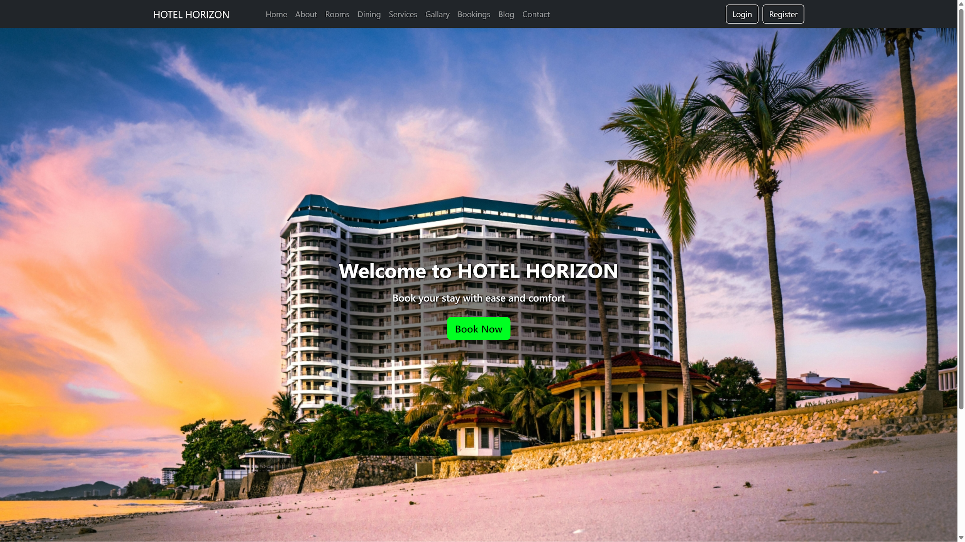
Front UI

Slide 17
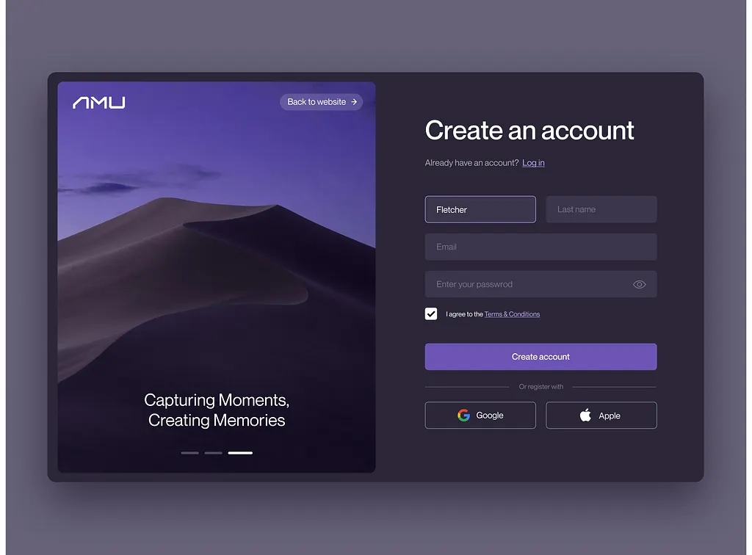
Registration Form

Slide 18
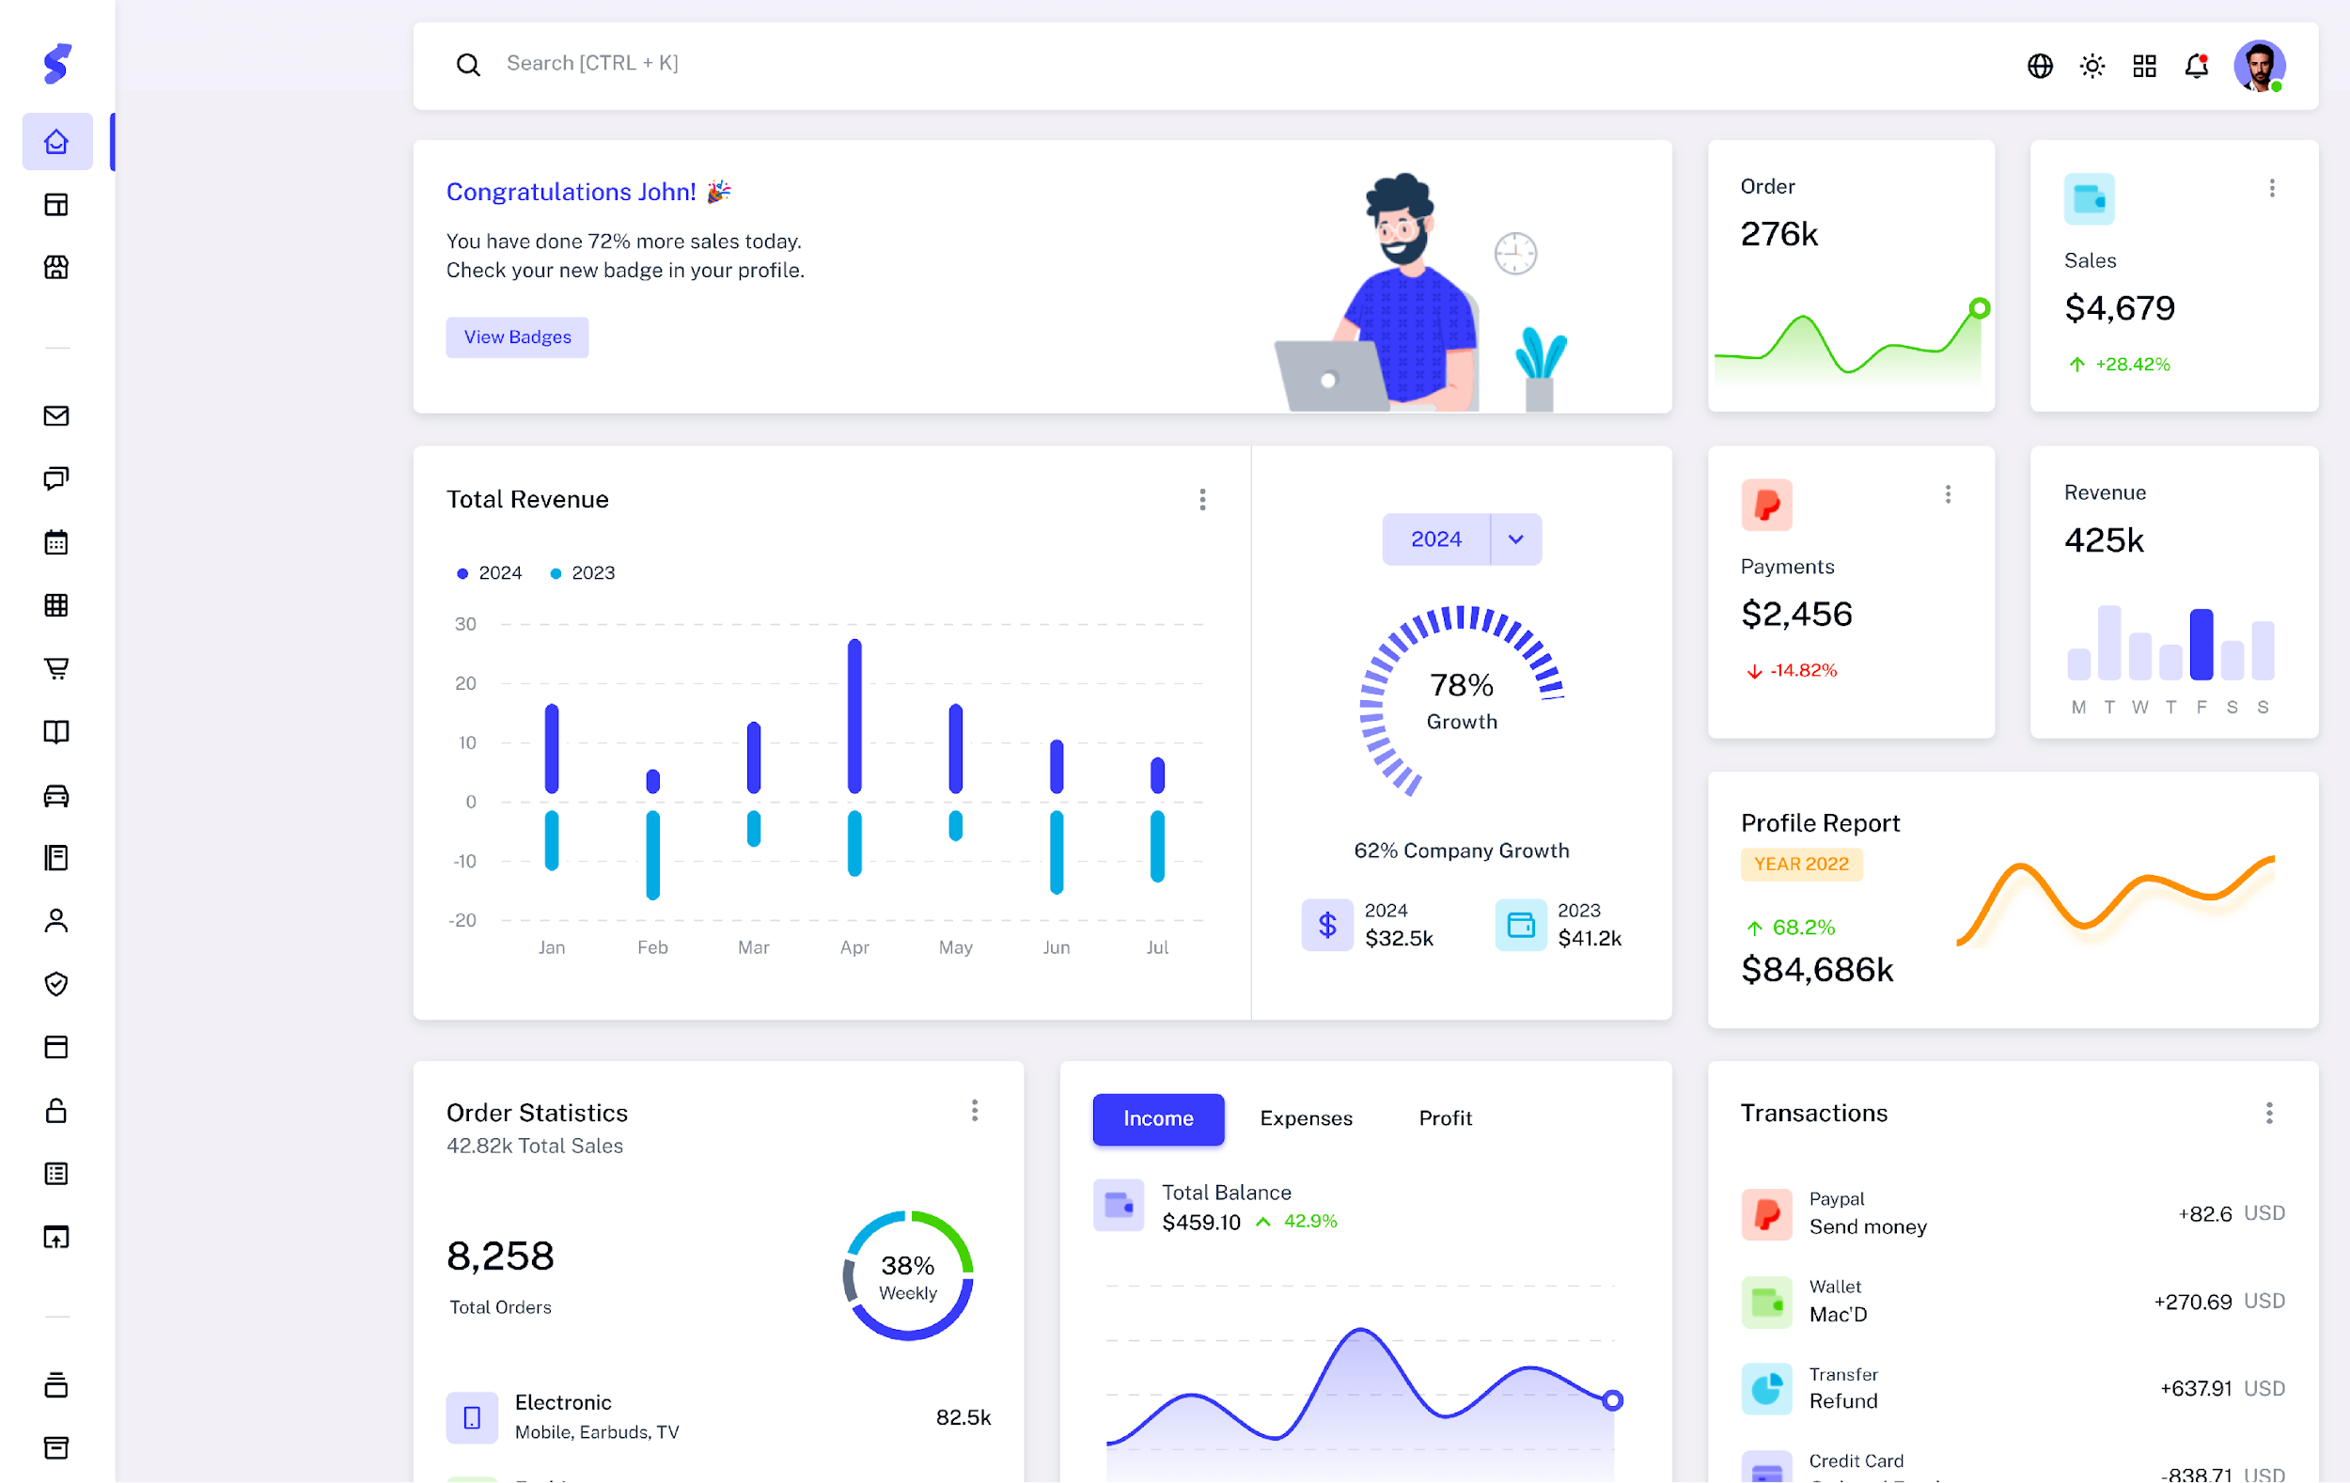
Admin Dashboard

Slide 19
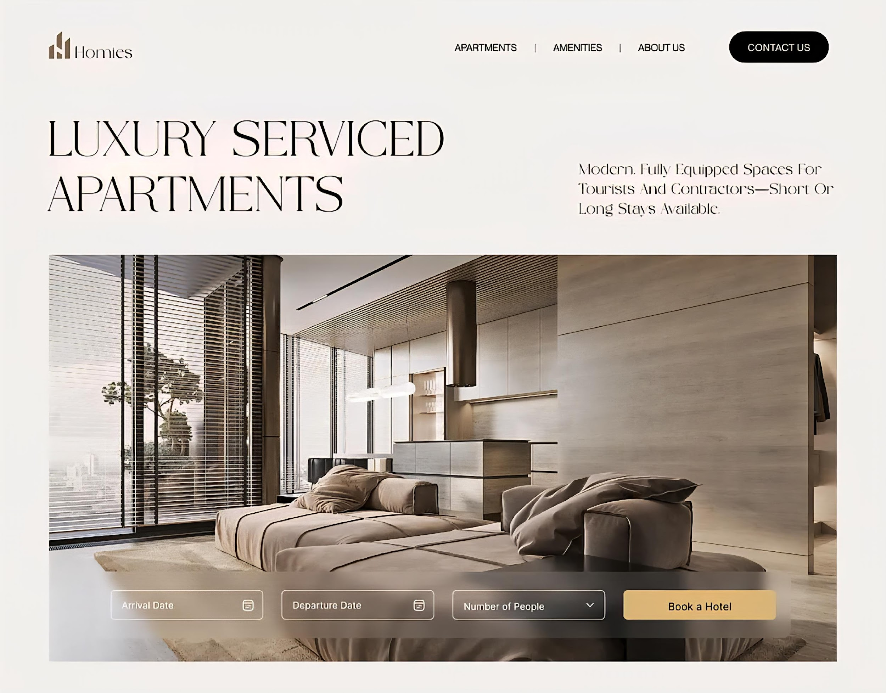
Room Booking

Slide 20
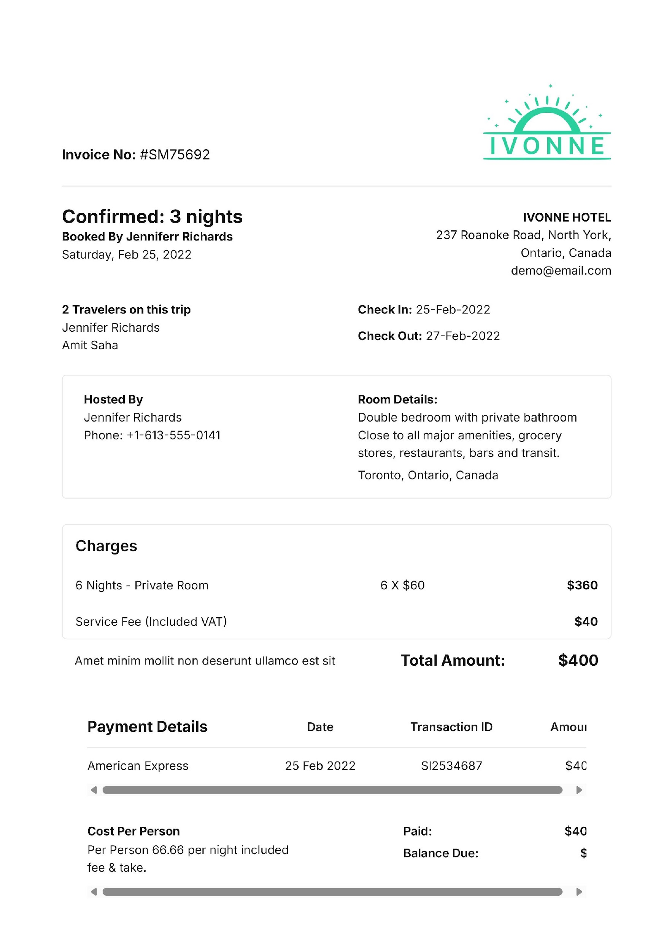
Invoice

Slide 21
Security Measures
◈ Implementation of user authentication to verify user identities before granting access.
◈ Use of password hashing (e.g., bcrypt) to securely store user passwords.
◈ Protection against SQL Injection through prepared statements and parameterized queries.
◈ Session management to maintain secure login states and prevent unauthorized access.
◈ Role-based access control to restrict user permissions according to their roles.
◈ Regular validation and sanitization of user inputs to avoid security vulnerabilities.

Slide 22
Testing and Validation
◈ Conducted functional testing to ensure all system features work as intended.
◈ Performed to prevent incorrect or malicious data entry. input validation
◈ Tested user authentication and access controls for security robustness.
◈ Carried out usability testing to guarantee a smooth and intuitive user experience.
◈ Fixed bugs identified during testing phases to improve system stability.
◈ Ensured the system handles edge cases and error conditions gracefully.

Slide 23








Project Timeline Infographics
Project Planning
Database Design
Development
Deployment
Week 1
Week 2
Week 3
Week 4
Week 5
Week 6
Week 7
Week 8
Requirement Analysis
UI/UX Design
Testing
Maintenance

Slide 24
Budget
Item | Description | Estimated Cost (BDT)
Development | PHP, MySQL, Coding Hours | 80,000
Testing | Manual and Automated Testing | 15,000
Deployment | Hosting and Domain | 12,000
Maintenance | Bug fixes, Updates and User Support | 20,000
Total Cost |  | 1,27,000

Slide 25
Conclusion
✓ Developed a system that automates hotel operations like room booking and user management.
✓ Implemented two user roles: Admin and Customer with secure access control.
✓ Designed a clean, intuitive user interface for easy navigation.
✓ Reduced manual work and minimized errors, improving overall efficiency.
✓ Ensured data security and privacy throughout the system.
✓ Future scope includes online payment integration and advanced reporting features.

Slide 26
Questions & Answers
You’re free to ask any questions about this project.

Slide 27



THANK YOU ALL
ASSADUZZAMAN SHAON
assad.uz255@gmail.com​
www.assad-uz.com

